Slide 1
Text Here

Slide 2
Text Here

Slide 3
Text Here
Text Here
Text Here
Text Here
Text Here
Text Here

Slide 4
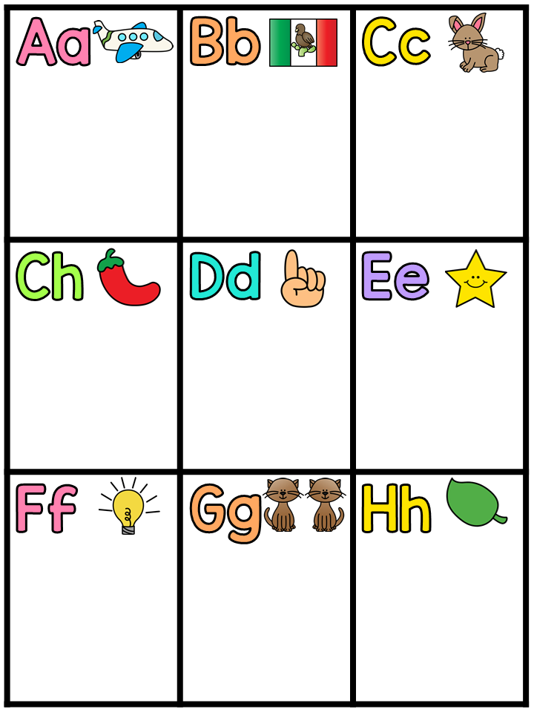
Text Here
Text Here
Text Here
Text Here
Text Here
Text Here
Text Here
Text Here
Text Here

Slide 5
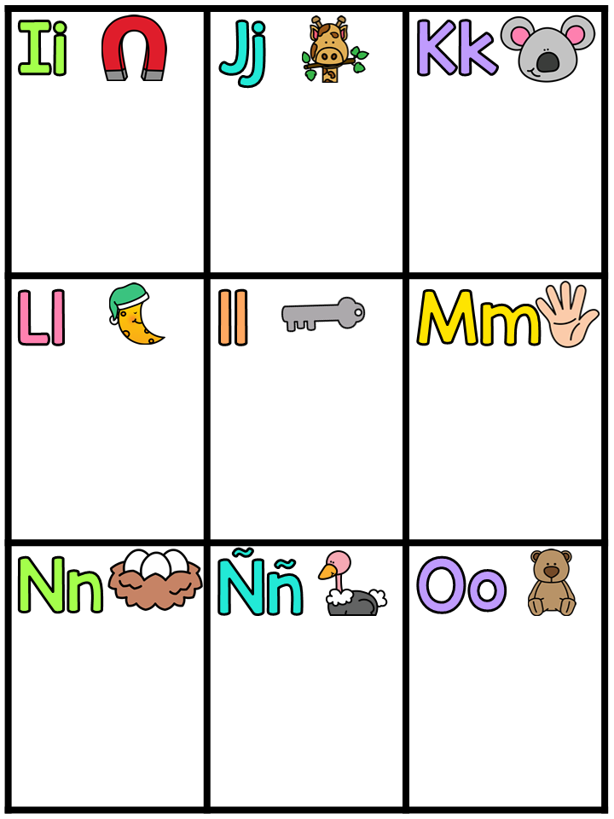
Text Here
Text Here
Text Here
Text Here
Text Here
Text Here
Text Here
Text Here
Text Here

Slide 6
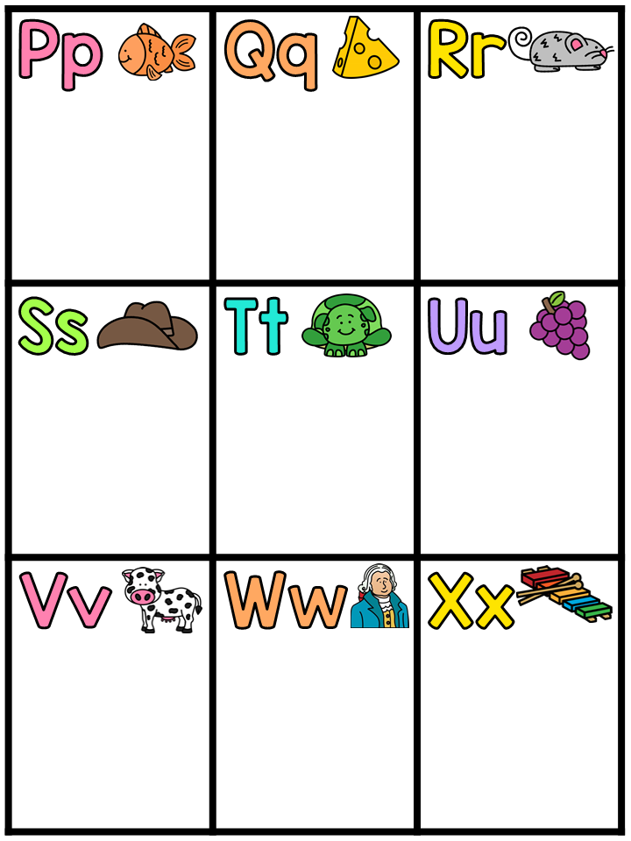
Text Here
Text Here
Text Here
Text Here
Text Here
Text Here
Text Here
Text Here
Text Here

Slide 7
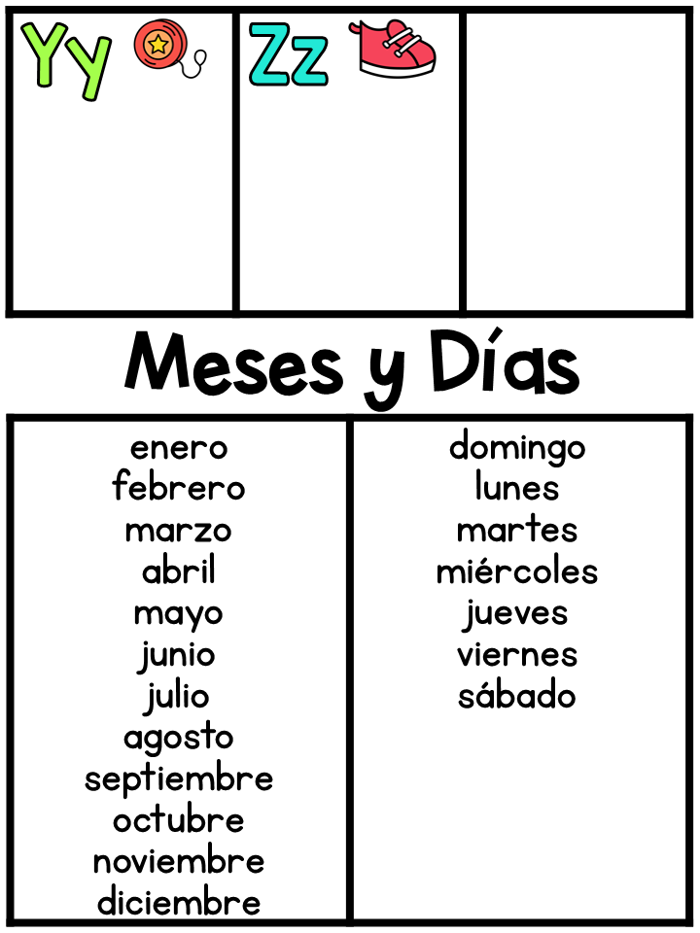
Text Here
Text Here

